Slide 1
Part 1: What is human-centered design?
Colin MacArthur
in partnership with the U.S. Forest Service

Slide 2
An approach for engaging end users in product development.

Slide 3
Engaging users in product development is hard.

Slide 4
Their feedback is vague, untechnical and sometimes inactionable.

Slide 5
Sometimes what people say turns out to be wrong.

Slide 6
There are a lot of end users–
so you get lots of hard feedback.

Slide 7
And then you don’t know which feedback to take!

Slide 8
Human-centered design is an approach for engaging end users that yields actionable, prioritized, assumption-challenging results.

Slide 9
Human-centered design builds products that work better for users, require less rework and prompt fewer support calls.

Slide 10
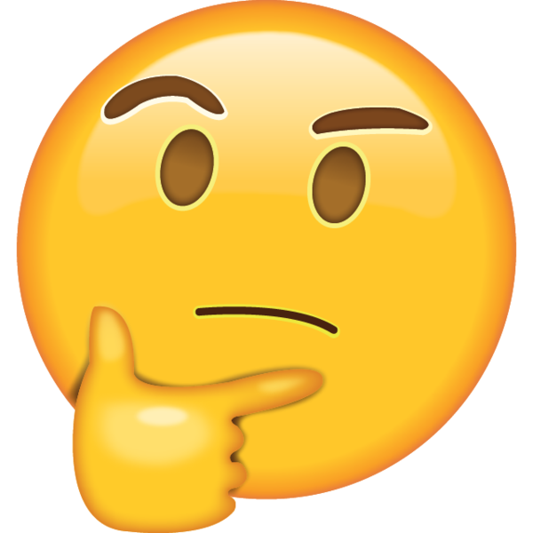
Human-centered design versus business analysis?

Slide 11
Business analysis vs. human-centered design
Complementary tool sets
Human-centered design strengths
Business analysis strengths
Interface design
Data architecture
User flow
Business process
User needs
Business goals
Users
Stakeholders

Slide 12
Four tenets of human-centered design:
Put people before technology.
Conduct design research.
Focus on common user needs.
Only accept proof in use.

Slide 13
Examples from ePermit along the way.

Slide 14
I will pose critical questions throughout.

Slide 15
1/ Put people before technology

Slide 16
We figure out how the best way to meet people’s needs and then figure out how to make it work within our constraints.

Slide 17
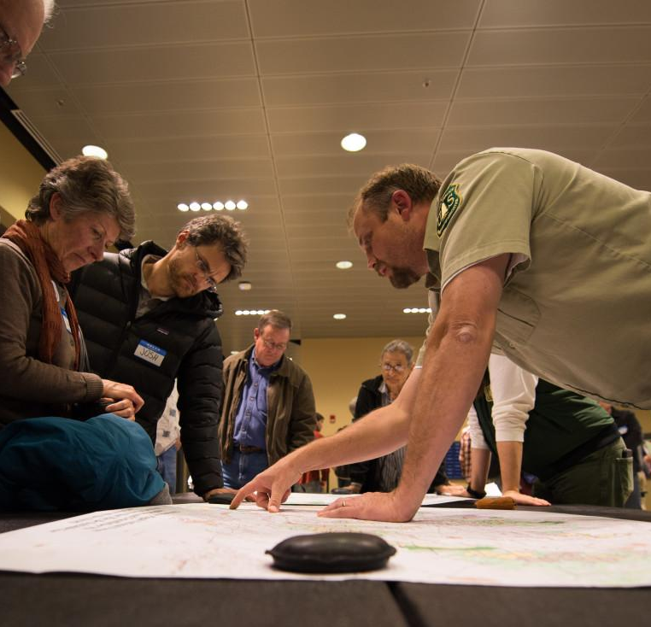
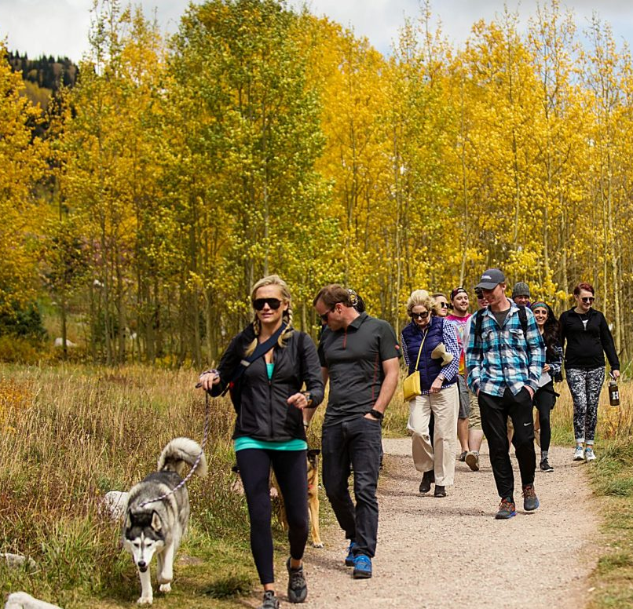
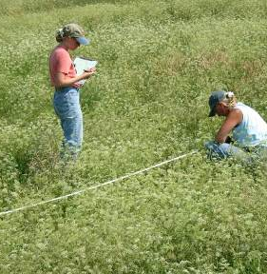
What are use needs?
User needs
Notes:
Users usually aren’t managers or developers or even experts. They’re members of the public and front line staff.

Slide 18
User needs versus other constraints
Policy/tech constraints
Stakeholder needs
User needs

Slide 19
Why not start with your technical constraints?

Slide 20
Overlap between what we can do and what users need
What we
can do
(from business
analysis)
What users
need
(from human-
centered design)

Slide 21
Limitations first what we see
What we
can do
Limitations first:

Slide 22
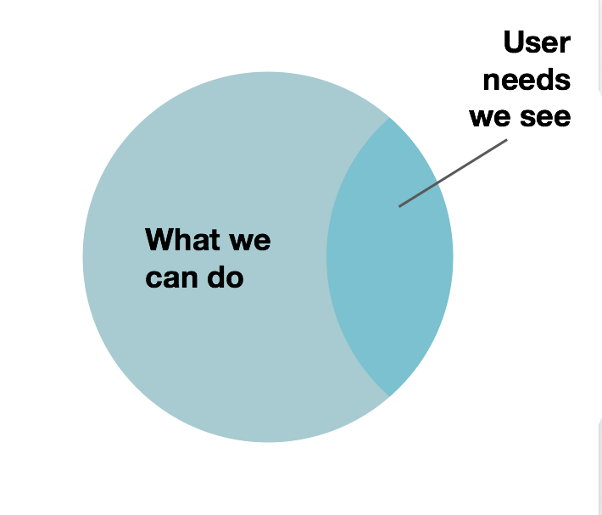
Limitations first limits user needs
Limitations first:

Slide 23
If we start by looking for limitations, we only see the user needs we can meet within them.

Slide 24
Users first what we see
What users
need
Users
first:

Slide 25
Users first the overlap between needs and what we can do
What we
can do
What users
need
Users
first:

Slide 26
What we can do expands from user needs
What we
can do
Users
first:
What users
need
Notes:
If we start with what

Slide 27
If we start with user needs, we can see what needs we can’t meet within our current limitations and work on expanding them.

Slide 28
Example from ePermit:
SUDS connection

Slide 29
We hear from users:
“All it needs to be...an applicant submits a form, we review it and accept it in.”

Slide 30
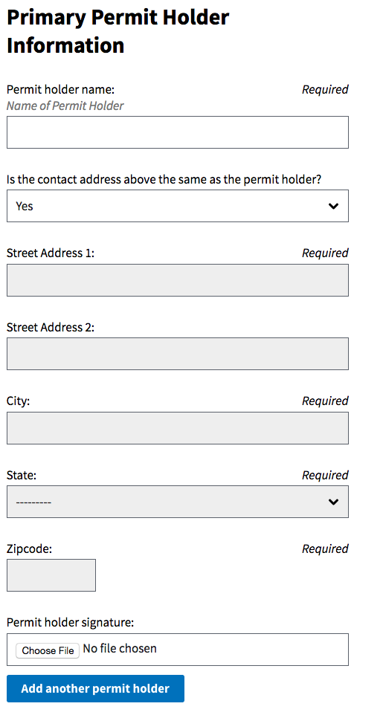
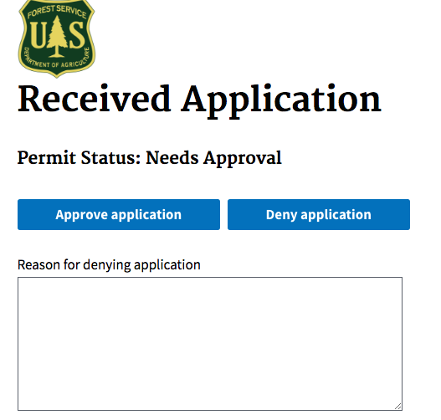
We build a prototype in a week:

Slide 31
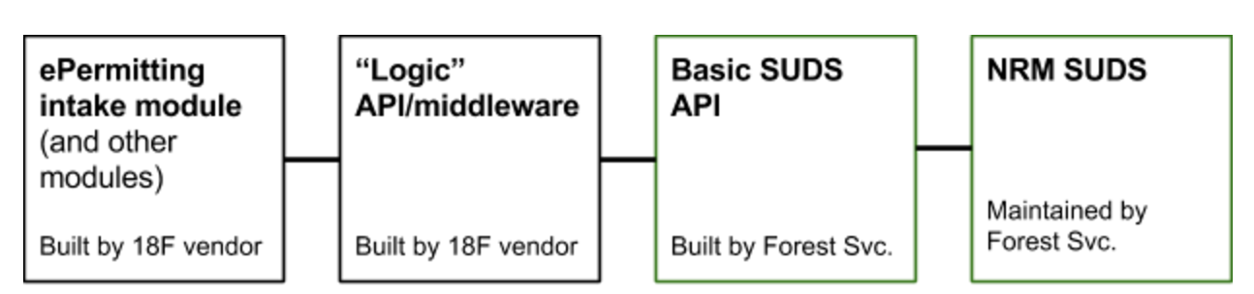
What we built:

Slide 32
If we’d started thinking about ePermit and SUDS in silos, we might never have gotten there.

Slide 33
2/ Conduct design research
Notes:
We find out peoples’ needs by observing and speaking directly with them with established research methods (not via surrogates or our own assumptions).

Slide 34
We find out peoples’ needs by observing and speaking directly with them with design research methods (not via surrogates or our own assumptions).

Slide 35
In design research:
Participants are users, people who touch the software.
Many participants in one-on-one sessions, not large groups
Standardized questions and targets of observation
Observing and asking about behaviors, instead of opinions

Slide 36
Contextual inquiry
Go to the places users work.
Ask them what they do, observe and ask follow up questions.
Repeat with different users.

Slide 37
Why not experts or proxies?

Slide 38
The problem with proxies
!
!
!
!
User
User
User
User
!
Representative

Slide 39
If we rely on experts or representatives, they rarely capture the diversity of process or opinion.

Slide 40
Why not just a big meeting?

Slide 41
The problem with one big meeting
!
!
!
!
User
User
User
User
Meeting
!
!
!
!
User
User
User
User

Slide 42
If you get everyone in a meeting together, all their opinions start to look the same.

Slide 43
Why not informal, loose conversations?

Slide 44
What happens when questioner asks one user informally
User
User
User
User
Questioner

Slide 45
What happens when another questioner asks a user informally
User
User
User
User
Questioner

Slide 46
What happens when a questioner asks yet another user informally
User
User
User
User
Questioner

Slide 47
The questioner’s erroneous conclusion
User
User
User
User
Questioner

Slide 48
If the conversations are informal, we usually don’t talk about all parts of process with everyone. Just some parts with some people.

Slide 49
Wait! Aren’t user opinions important?

Slide 50
The problem with user opinions
!
!
!
!
User
User
User
User
! ! ! ! !
Representative

Slide 51
Opinions without an understanding of what people actually do are rarely actionable.

Slide 52
In review, in design research:
Participants are users, people who touch the software.
Many participants in one-on-one sessions, not large groups
Standardized questions and targets of observation
Observing and asking about behaviors, instead of opinions

Slide 53
Example from ePermit:
Research surprises

Slide 54
Just collecting online applications won’t help outfitters and guides. Helping them choose the right permit and submit the right documentation will.

Slide 55
3/ Focus on common needs

Slide 56
We build products that meet the needs shared by the most people and meet address business goals.

Slide 57
The trade offs between relevant goals and user needs
Most relevant to goals
(from business analysis)
Build here!
Business likes, but users won’t cooperate
Unsustainable
user-chasing
Vocal minority
Most users need
(from human-centered design)

Slide 58
Example from ePermit:
Feature prioritization

Slide 59
Example tradeoffs from ePermit
Most relevant to goals
Validating form
Forcing users to consume certain docs.
SUDS connect.
Fewer hoops
Idiosyncratic
processes
Most users need

Slide 60
Aren’t we here to focus on business needs?

Slide 61
What we assume about goals and user needs
Our goals
What users
need
What
we
think:

Slide 62
What’s actually true
Our goals
What users
need
What’s
usually
true:

Slide 63
When we help users,
they want to help us.

Slide 64
4/ Only accept proof in use

Slide 65
We’re only done when we see evidence users can accomplish their goals (also via design research).

Slide 66
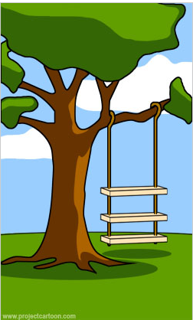
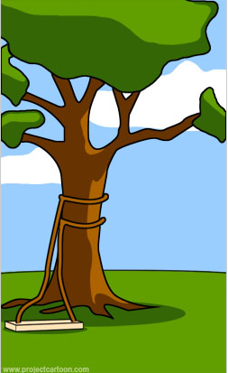
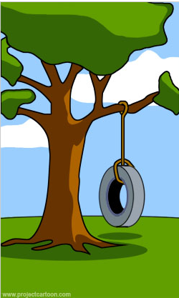
The difference between what’s said, heard and built
What users said
What we heard
What we built
What’s needed

Slide 67
Usually, what we hear, what we make and what’s needed aren’t aligned the first time.

Slide 68
So we conduct usability testing...
Give a user a working software.
Ask them to complete a task, observe and be quiet.
Repeat with different users.

Slide 69
Don’t we usually get it right the first time?

Slide 70
Example from ePermit:
Unexpected reaction to forms

Slide 71
We heard from everyone:
“We just need the same form online.”

Slide 72
We put the form online:

Slide 73
Then we heard:
“Wait! I don’t know what that means.”
“Wait! That’s going to mislead people.”

Slide 74
In sum...

Slide 75
Review: Four tenets of human-centered design:
Put people before technology.
Conduct design research.
Focus on common user needs.
Only accept proof in use.

Slide 76
Part 2:
HCD to NRM
Colin MacArthur
in partnership with the U.S. Forest Service

Slide 77
What’s next?

Slide 78
NRM HCD jumpstart modules
Discovery and in-person intensive
Contextual inquiry
Usability testing
Journey mapping
Visioning
Next steps roadmap

Slide 79
6-10 jumpstart participants
Once or twice:
Attend 2 day intensive (uninterrupted)
Monthly until Feb:
2 hour webinar
2 ½ hour coaching sessions
Throughout:
Willingly apply techniques to their projects
After jumpstart:
Serve as experts and champions

